Slide 1
Hosea 何西阿書 10:1-8

Slide 2
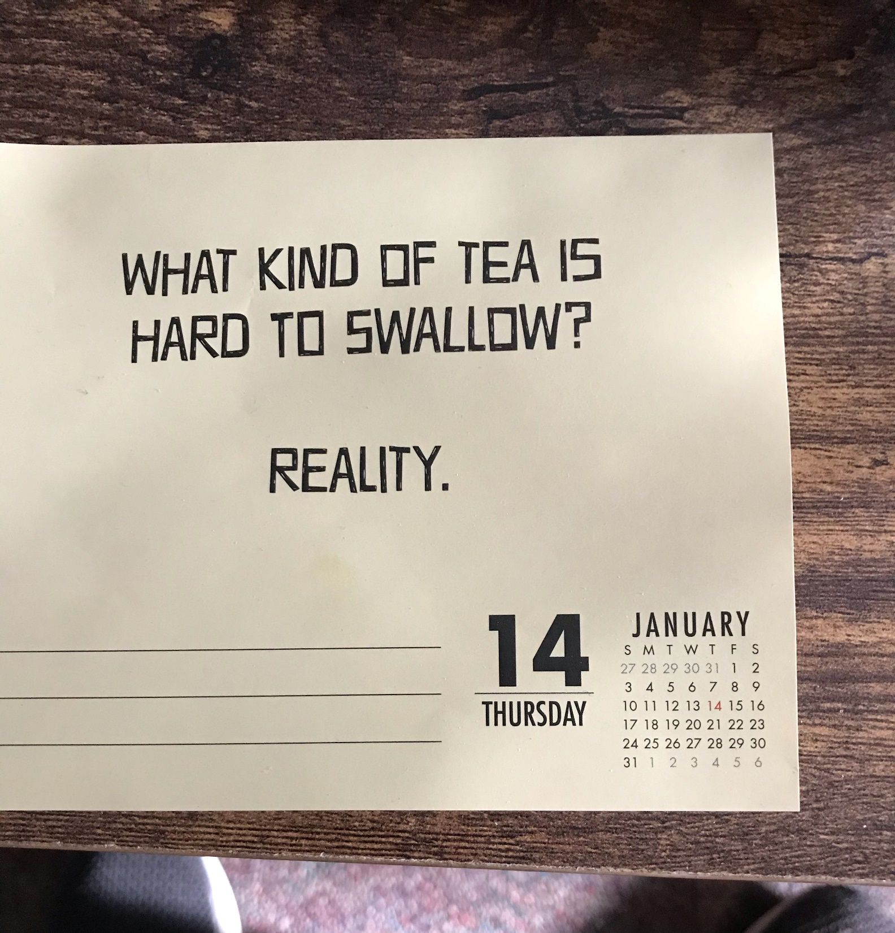
哪一種茶最難吞嚥？
現實

Slide 3
Hosea 10:1-8
1 Israel was a spreading vine; he brought forth fruit for himself. As his fruit increased, he built more altars; as his land prospered, he adorned his sacred stones.
2 Their heart is deceitful, and now they must bear their guilt. The Lord will demolish their altars and destroy their sacred stones.
何西阿書 10:1-8
1 以色列是茂盛的葡萄樹，結果繁多；果子越多，就越增添祭壇；地土越肥美，就越造美麗的柱像。
2 他們心懷二意，現今要定為有罪；耶和華必拆毀他們的祭壇，毀壞他們的柱像。

Slide 4
“Our Prosperity & Our Relationship with God”
我們的豐盛富足和我們與上帝的關係

Slide 5
Hosea 10:1 Israel was a spreading vine; he brought forth fruit for himself.
AS YOU PROSPER, IS IT JUST FOR YOURSELF?
何西阿書 10:1 以色列是茂盛的葡萄樹，結果繁多
當你富足 ，是否只為了自己？

Slide 6
Hosea 10:1 As his fruit increased, he built more altars; as his land prospered, he adorned his sacred stones.
AS YOU PROSPER, DO YOU WORSHIP THE WORLD AND YOURSELF MORE & MORE?
AS YOU PROSPER, WHAT ALTARS HAVE YOU BUILT? WHAT IDOLS DO YOU BOW DOWN TO?
何西阿書 10:1 果子越多，就越增添祭壇；地土越肥美，就越造美麗的柱像。
當你變得富足 ，你是否越來越敬拜這個世界和自己？
當你變得富足 ，你築起了哪些祭壇？你向哪些偶像下拜？

Slide 7
MODERN DAY ALTARS WE BUILD & WORSHIP
CARS / BOATS / TOYS/ GUCCI HAND BAG – Materialism
HOUSE
BODY FIGURE
STATUS & TITLE
CHILDREN
SELF
我們在當今社會所築起並敬拜的祭壇
汽車 / 船 / 玩具 / 古馳包 —— 物質主義
房子
身體 , 外貌
身份, 頭銜
兒女自己

Slide 8
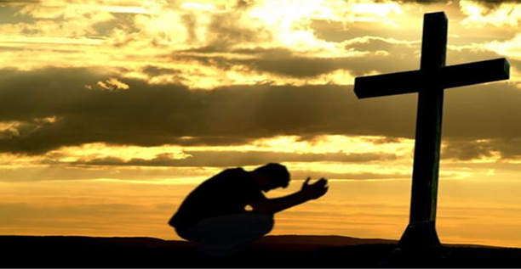
Mark 8:34 “Deny yourself, take up your cross & follow me.”
Romans 12:1 … offer your bodies as a living sacrifice, holy and pleasing to God—this is your true and proper worship.
馬可福音 8:34：『若有人要跟從我，就當捨己，背起他的十字架來跟從我。』
羅馬書 12:1：「將身體獻上，當作活祭，是聖潔的，是神所喜悅的；你們如此事奉乃是理所當然的。」

Slide 9
Hosea 10:2 Their heart is deceitful,
IS YOUR HEART DIVIDED? (HAS YOUR HEART DECEIVED YOU?)
何西阿書 10:2 他們心懷二意
你是否也心懷二意？（你的心是否欺騙過你？）

Slide 10
Matthew 6:21 & 24 For where your treasure is, there your heart will be also. 24 No one can serve two masters. Either you will hate the one and love the other, or you will be devoted to the one and despise the other. You cannot serve both God and money.
馬太福音 6:21：「因為你的財寶在哪裏，你的心也在那裏。
6:24：「一個人不能事奉兩個主；不是惡這個、愛那個，就是重這個、輕那個。你們不能又事奉神，又事奉瑪門（瑪門：財利的意思）

Slide 11
Hosea 10:2 Their heart is deceitful, and now they must bear their guilt.
GOD HAS PROSPERED YOU, BUT YOU HAVE CHOSEN TO LIVE FOR & WORSHIP THE WORLD AND YOURSELF, SO NOW THERE WILL BE CONSEQUENCES.
何西阿書 10:2 他們心懷二意，現今要定為有罪；
上帝使你興旺，然而你卻敬拜世界與自己，所以現在必須承擔後果。

Slide 12
SOME OF THE CONSEQUENCES AND JUDGMENTS 0N THE ALTARS AND IDOLS ISRAEL BUILT (HOSEA 10:2-8)
以色列建造的祭壇與偶像招致的後果與審判
10:2 The Lord will demolish their altars and destroy their sacred stones.
YOUR ALTARS & IDOLS YOU TRUST IN & WORSHIP WILL BE DESTROYED
10: 2 耶和華必拆毀他們的祭壇，毀壞他們的柱像。
你所信靠、所敬拜的那些祭壇與偶像，終必被拆毀。

Slide 13
10:5 The people who live in Samaria fear for the calf-idol of Beth Aven…… because it is taken from them into exile. 6 It will be carried to Assyria as tribute for the great king….
YOUR ALTARS & IDOLS YOU TRUST IN & WORSHIP WILL BE LOST
10:5 撒瑪利亞的居民必因伯‧亞文的牛犢驚恐；崇拜牛犢的民和喜愛牛犢的祭司都必因榮耀離開他而悲哀。6 人必將牛犢帶到亞述，當作貢物獻給耶雷布王
你所信靠、所敬拜的祭壇與偶像，終將失去

Slide 14
10:8b Thorns and thistles will grow up and cover their altars.
YOUR ALTARS & IDOLS YOU TRUST IN AND WORSHIP WILL BE FORGOTTEN.
10:8b 荊棘和蒺藜要長在他們的祭壇上
你所依賴、所敬拜的祭壇與偶像，終將被遺忘

Slide 15
Review & Prayer 回顧與禱告
AS YOU PROSPER, IS IT JUST FOR YOURSELF?
AS YOU PROSPER, DO YOU WORSHIP THE WORLD AND YOURSELF MORE & MORE?
AS YOU PROSPER, WHAT ALTARS HAVE YOU BUILT? …IDOLS DO YOU BOW DOWN TO?
IS YOUR HEART DIVIDED? (HAS YOUR HEART DECEIVED YOU?)
當你富足 ，是否只為了自己？
當你變得富足 ，你是否越來越敬拜這個世界和自己？
當你變得富足 ，你築起了哪些祭壇？你向哪些偶像下拜？
你是否也心懷二意？（你的心是否欺騙過你？）

